Slide 1

NATURAL LANGUAGE PROCESSING

Slide 2
HANDLING TEXT IN ML
So far, all algorithms that we have seen take as input tabular information with numeric or categorical data (and a brief stint with datetime data when we looked at time series)
There are several areas of application where our data is not natively structured in this way: sound, image and text come to mind
In these situations we often reduce the problem to turning the native data format into a suitable set of features, followed by applying the typical ML algorithms.
In other words: how do we turn text into a suitable set of numbers?

Slide 3
HANDLING TEXT IN ML - NAIVE APPROACHES
Some of this feature generation can and should come from metadata:
source of text
date of production
author
number / type of interactions
But ultimately it is clear that most of the information must come from the body of the text.
We have seen the bag-of-words model before, but that approach had some shortcomings that we will try to address in this class.

Slide 4
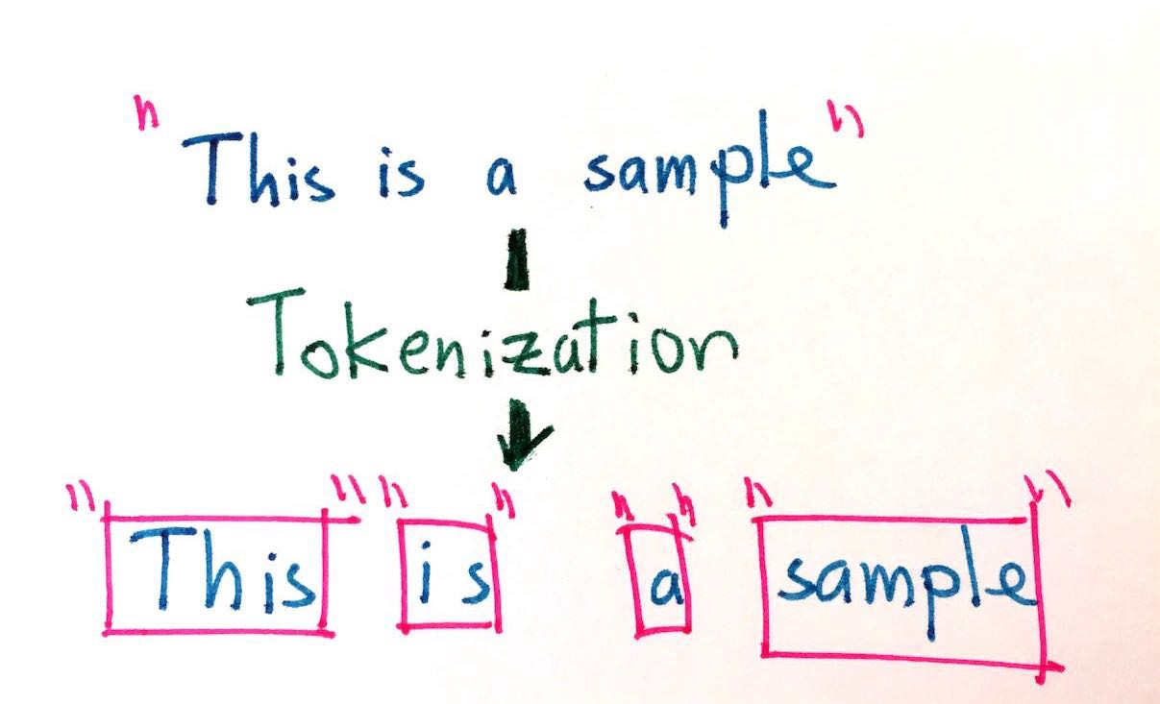
TEXT DATA CLEANING TECHNIQUES
Tokenization
The process involves taking any text and splitting it into "tokens"
Usually the tokens chosen are individual words but can be sentences as well.
PROBLEMS: YOU CAN LOSE IMPORTANT MEANING LIKE "NEW YORK" GETS SPLIT INTO "NEW" AND "YORK" THUS LOSING THE GEOGRAPHICAL MEANING. A GOOD MACHINE LEARNING APPLICATION WOULD TAKE THIS INTO CONSIDERATION BY CONSIDERING THE RELATIVE FREQUENCYOF PAIRS OF WORDS AND PERHAPS KEEP THOSE PAIRS AS A SINGLE WORD
To collab...

Slide 5
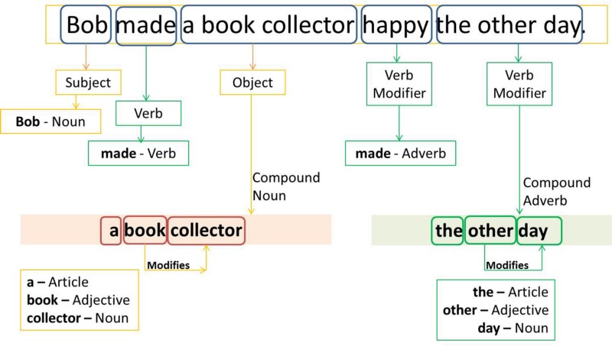
TEXT DATA CLEANING TECHNIQUES
Part-of-Speech tagging (POS)
Can be a very valuable feature
Used heavily in Natural Language Generation (NLG)
In that usecase the "next word" is heavily dependent on the previous
To collab...

Slide 6
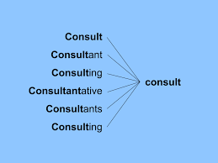
TEXT DATA CLEANING TECHNIQUES
Stemming
Removing prefixes and suffixes in order to
reduce synonym words into their common form
This can lead to some problems of creating spurious relations
Stripes -> Strip
Strip -> Strip
To collab...

Slide 7
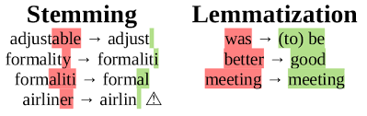
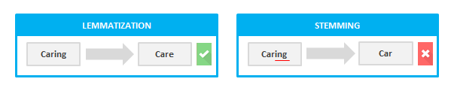
TEXT DATA CLEANING TECHNIQUES
lemmatization looks beyond word reduction and considers a language’s full vocabulary to apply a morphological analysis to words. The lemma of ‘was’ is ‘be’ and the lemma of ‘mice’ is ‘mouse’.
To collab...

Slide 8
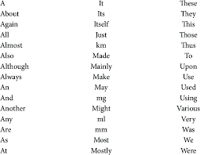
TEXT DATA CLEANING TECHNIQUES
Removal of stop words
Stop words are common words which are usually removed to not be interpreted as noise
To collab...

Slide 9
BAG OF WORDS
Bag of Words model is a standard way to decompose any text into several features that can then be used to train a classifier.
The method consists of taking all the words from all the corpuses/documents/rows and performing one-hot encoding. However, the final value is a frequency of the word rather than a binary variable
In essence, each distinct word becomes a feature

Slide 10
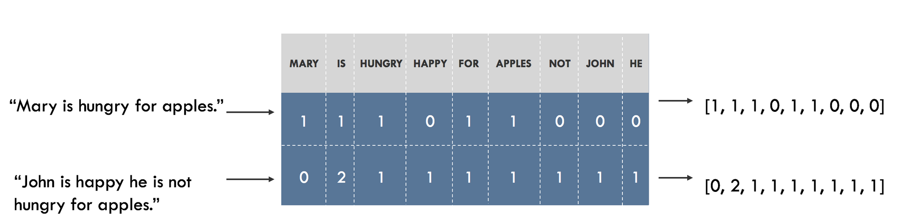
BAG OF WORDS

Slide 11
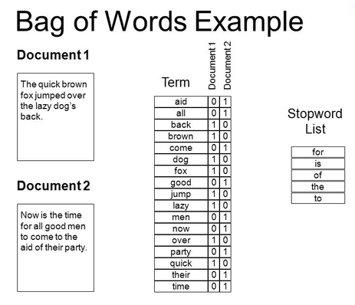
BAG OF WORDS
Problems of bag of words:
- you lose the context of the words within the sentence
- assumes all words are independent
"this is not bad" -> "bad"
solution: N-Grams performing bag of words but with pairs of sequential words for example:
"this is" ; "is not" ; "not bad" would be your features
To collab...

Slide 12
TF-IDF
Term Frequency Inverse Document Frequency (TF-IDF) is one of the most important feature engineering techniques in natural language processing
Weighs how important a word is in a specific document and how rare it is in all the collections of documents
High TF-IDF score -> word appears many times in a document but is rare in collection of documents -> ”Capitol", "Trump"
Low TF-IDF score -> word that appears moderately in a document but is extremely common in collection of documents -> "Today", "Furthermore"

Slide 13
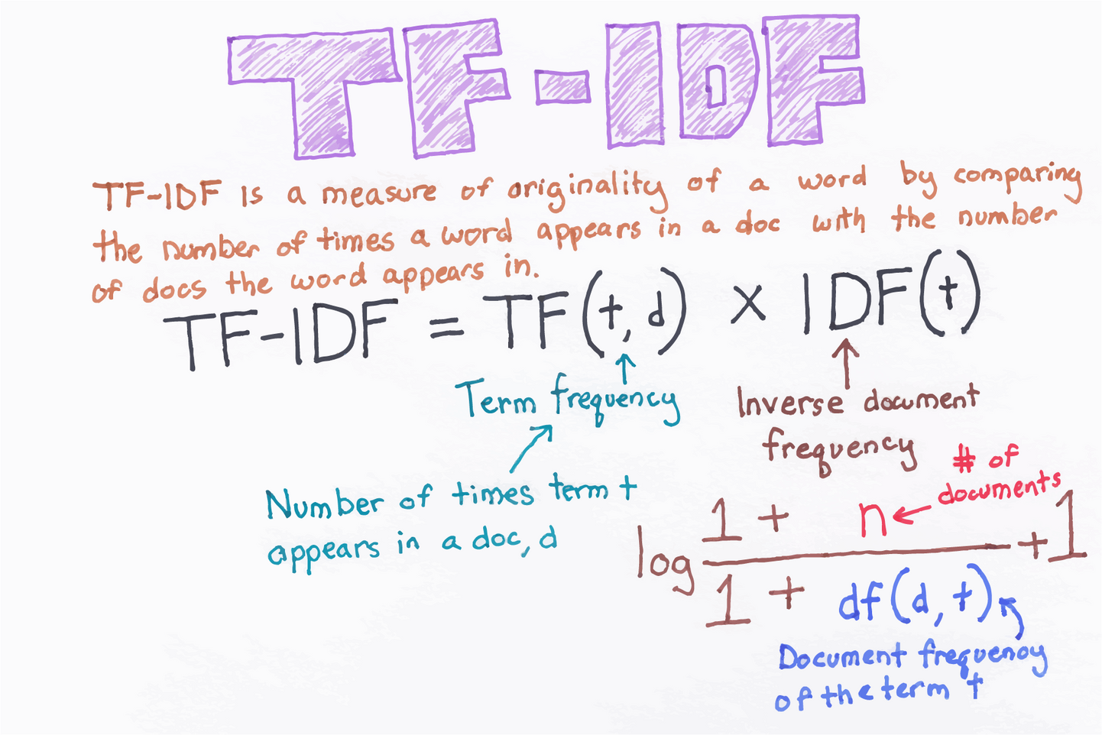
TF-IDF

Slide 14
ANY QUESTIONS ?

